Slide 1
SOEN-7761 – Project Presentation
Intelligence to MyPHR Application
NOVEMBER 21st 2013
TEAM D :
Arundeep Malapati
Deepak Chandrashekar
Manoj Kumar Chowdary

Slide 2
INTRODUCTION
“Our bodies are our gardens – our wills are our gardeners.”
-William Shakespeare
“Take care of your body. It’s the only place you have to live.”
-Jim Rohn

Slide 3
INTRODUCTION
Health plays a vital role in people’s life; hence health must be constantly monitored.
There are various ways to monitor the health status like
Visiting to the doctor
Taking vital signs and validating
Mobile technology has made a significant improvement in the growing world.

Slide 4
INTRODUCTION
One of the targeted mobile applications is that which can help to monitor the health status by providing various features.
Features like recording the vital signs measurements, treatment history, etc.
It also reduces the paperwork and helps illiterates including literates.

Slide 5
Motivation
It is important for individuals to maintain the health records in their lifetime.
The Classical way of maintaining the health documents and records in a file or folder becomes hard.
There is a chance of losing or misplacing of some important health documents.
The Illiterate people are not aware of keeping track the health documents.

Slide 6
Motivation
The common problem that everyone may face while maintaining the health records are :
When people want to compare and analyze the vital sign readings considering their health background.
When people need to take medication or record vital signs readings at regular interval of time.

Slide 7
Motivation
To overcome some of the following issues, My PHR application is developed.
It can be used to avoid the paper work and to maintain records in an easy manner.
By graphical representation we can compare the vital signs easily and analyzing such information becomes easy.

Slide 8
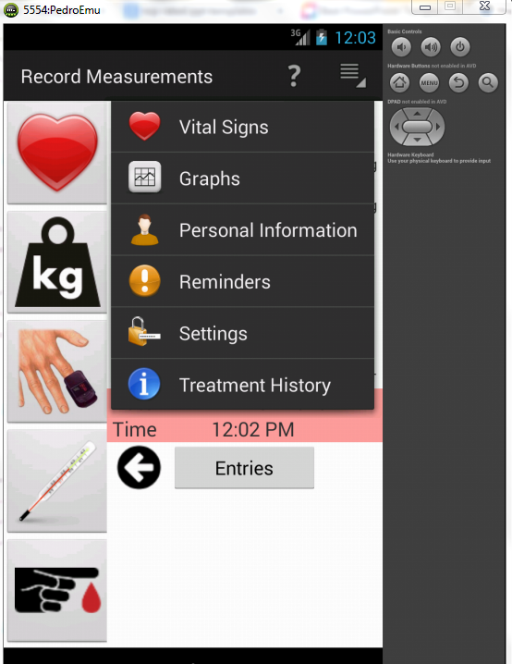
Existing System
In existing app there are so many features like
Recording vital signs
View/Analyze the graphs
Add/update the personal information
Set up the reminders
View your Treatment history
Modify any of the settings

Slide 9
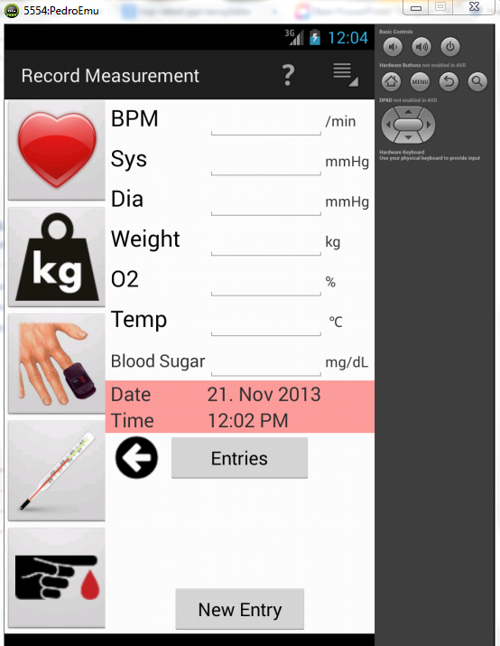
Existing system
The vital signs present in the app are blood pressure, Weight, oxygen saturation, Temperature and sugar levels.
We can record the measurements of required vital signs and can save their entries.

Slide 10
Enhanced system with Intelligence
New intelligence added to the existing app are
When user enters the values for the vital sign, the UI should ask user whether he need a reminder for next intake of vital sign.
When the vital sign values saved, the severity level is indicated based on the values are normal, above or below the normal values.
If the vital sign is increasing above normal compared to previous value OR decreasing below normal value compared to previous value then alert the user.

Slide 11
Design - Severity Level
When the vital sign values saved, the severity level is indicated based on the values are normal, above or below the normal values.
Normal – Indicated by Green Color
Low – Indicated by Yellow Color
High – Indicated by Red Color
Advantage
Unobtrusive to the user
Easy to understand for both literates and illitrates

Slide 12
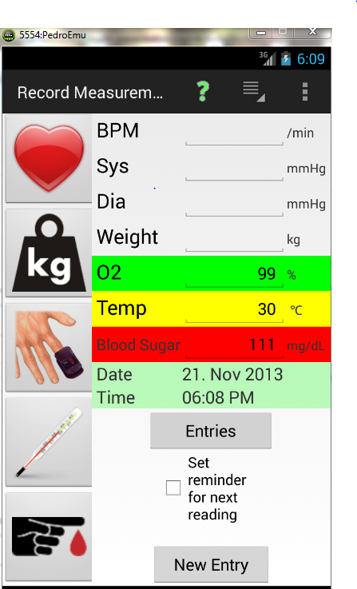

Slide 13
Design - Alerting the User
If the vital sign is increasing above normal compared to previous value OR decreasing below normal value compared to previous value then alert the user.

Slide 14
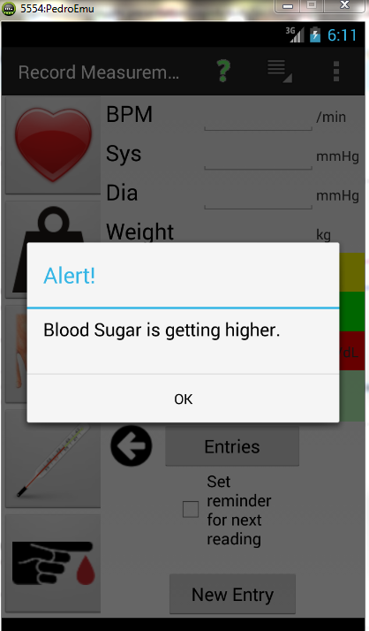

Slide 15
Design – Reminder for next reading
When user enters the values for the vital sign, the UI should ask user whether he need a reminder for next intake of vital sign.
It is unobtrusive since checkbox is used
Only if user select the checkbox, user can set the reminder
This option is disabled if reminder is set multiple times, which serves the purpose.
This option is more useful for old people who often forgets the things

Slide 16
Design – Reminder for next reading
Reminder | Check Box | Single/Multiple Reminder
Enabled | Check Box selected | -
Disabled | Check Box de-selected | Set Multiple Reminder

Slide 17
Design
This application is a knowledge based system. It contains Facts and Rules (i.e., if-then-else).
Severity of the V-sign values:
The facts about the normal range of V-sign values are stored. The rules are as below –
If the user provided V-sign value is within the normal range as mentioned in the fact, then the severity level is considered as normal.
If the V-sign is greater than the normal range, then the severity level is considered as high.
If the V-sign is lesser than the normal range, then the severity level is considered as low.

Slide 18
Design
This application will help the user in organizing the vital sign readings, treatment history in an efficient and effective manner by following the properties of vital signs
Body Temperature {low, normal, high}
Oxygen Level {low, normal, high}
Blood Sugar {low, normal, high}

Slide 19
Design
The rules for relevant properties of vital signs are as follows:
For normal body temperature it should be between 97 – 100 F
Oxygen Levels (95-100%)
The normal sugar level is 70 to 100 mg/dl

Slide 20
Evaluations
We evaluated the usability of the MyPHR project involving the user under controlled settings to measure and observe users behaviour.
Our aim is to test the usability of our project for the intended user population (i.e. older and middle aged people) to achieve the task for which our project is designed.
We performed this usability test on certain number (say 3-5) of users in controlled settings.

Slide 21
Evaluations
Testing Conditions:
Selecting different participants who are older/middle aged.
Typically 3-5 participants.
Test condition should be same for every participant.
Test is conducted in a closed room like laboratory.
The task should not be more than half an hour.
Participants should be explained about the consent form and issues.
Testing Observations:
Number of errors made by users for a task is to be noted.
Time to complete the assigned task.
Type of errors made by users.
Common errors made by users.
Number of users successfully completing the tasks.

Slide 22
Evaluations
User | No: of Errors | Error Description | Task Status | Time Taken
User 1 | 3 | Type Mistake, unable to plot selected values on graph. | Successfully completed | 27 min
User 2 | 1 | Unable to plot graph for selected dates. | Successfully completed | 24 min
User 3 | 1 | Enter details for treatment history. | Successfully completed | 19 min
Usability is evaluated by selecting 3 participants of middle age. The participants are assigned with tasks which are held in controlled settings to test the My PHR application.
The user actions are observed and noted. Our aim is to test the specified age group (35 and above) users
So we planned accordingly to collect information. Collected information is given in the following table.

Slide 23
Evaluation
User satisfaction is evaluated by conducting interviews.
Few of them are :
What do you feel about this application?
User1: It is good, Useful health application.
User2: Good, but I have an Iphone in which this app is not supported.
User3: I don’t think it’s a good idea for me because I don’t like to monitor vital signs.

Slide 24
Do you like to set reminder for alerting to take readings?
User1: No, I am not, but this is helpful to people who often forget.
User2: I like this, no need to remember timings to record my sugar levels.
User3: Yes, I like this because it reminds me when I may forget to record vsigns due to my daily schedule.
Would you like to compare and notify the severity level of every vital sign?
User1: Not every value out of normal range is severe to a normal man like me, but when it comes to sick people it helps.
User2: It is good but Severity range may vary from one to other.
User3: Helpful sometimes, It shows how the present condition is compared to previous value but it does not mention how serious it is.

Slide 25
Limitations
Artificiality, User is not exposed to natural settings as it is a controlled setting experiment.
User behavior in laboratory might not be same as in natural environments.
Experiment is conducted on specified age group users.
No scope for technology evaluation.
Even though the experiments are conducted in controlled environments, it is not possible to control all the variables.

Slide 26
Challenges
The vital sign blood pressure severity depends on the age and gender of user
The vital sign weight severity depends on the height and age of the user
We don’t have any Android device and new to Android interface
Complexity in understanding the code
Emulator is slow to work

Slide 27
Conclusion
We have many ways to maintain the health data, but recording the values and maintaining the treatment history in mobile application helps user a lot.
They can track information even while on go.
Using the other way of electronic storing may need more technical knowledge like in computers we need to know how to plot graphs and create tables.

Slide 28
Conclusion
So we have a mobile application which creates an interest in technically illiterates including literates with the graphical and pictorial notations.
It is easy to access and user friendly interface.
This project was a very important learning experience for us.

Slide 29
References
Materials and Notes provided in the class.
Blood Sugar Level Chart and Normal Range of Values http://www.medindia.net/patients/calculators/bloodsugar_chart.asp#.
Blood Pressure Chart and Normal value Range http://www.mayoclinic.com/health/blood-pressure/HI00043

Slide 30
Thank You
&
Demo

